Slide 1
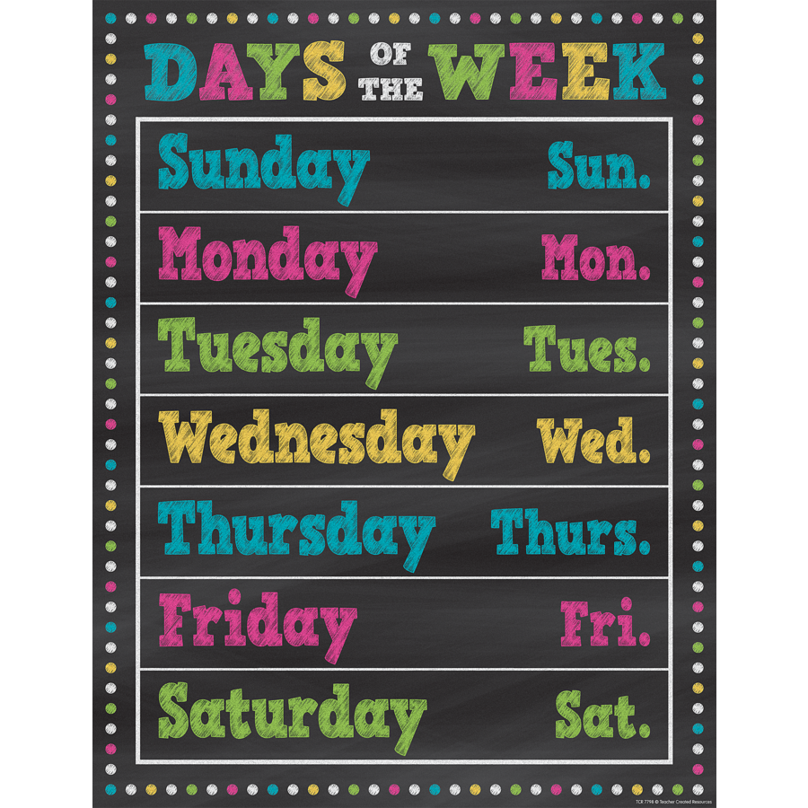
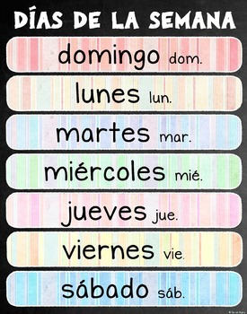
¿QUÉ DÍA ES HOY?

Slide 2
¿QUÉ DÍA ES HOY?
What day is today?
HOY ES ________.
Today is ______.

Slide 3
SUNDAY DOMINGO

Slide 4
MONDAY LUNES

Slide 5
TUESDAY MARTES

Slide 6
Wednesday miércoles

Slide 7
THURSDAY JUEVES

Slide 8
FRIDAY VIERNES

Slide 9
SATURDAY Sábado

Slide 10
FUN FACTS
In Spanish speaking countries, the week starts on Monday (lunes) whereas it starts on Sunday (domingo) in the United States.
Days of the week are not capitalized in Spanish like they are in English.

Slide 11
A SONG {una canción}
domingo
lunes
martes
miércoles
jueves
viernes
sábado
y domingo otro vez

Slide 12
SUNDAY DOMINGO
MONDAY LUNES
TUESDAY MARTES
WEDNESDAY MIÉRCOLES
THURSDAY JUEVES
FRIDAY VIERNES
SATURDAY SÁBADO

